Slide 1
GitHUB
Manjunath Reddy

Slide 2
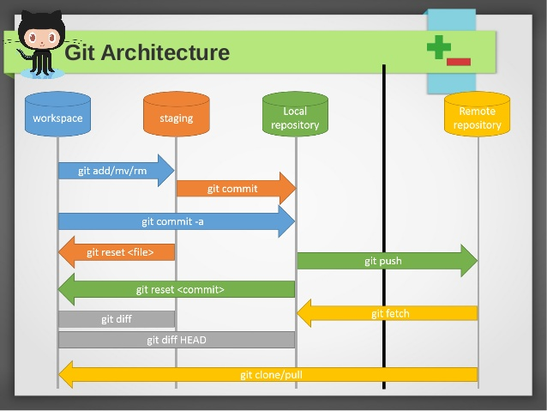
GitHub Architecture

Slide 3
GitHub Fundamentals
Completely Open Source.
Distributed and not Centralized
Single GitHub instance can host 3 million repos
Accessed through popular protocols like SSH and Https, Http.
Easily adaptable to DevOps due to readily available plugins by third party vendors.
Secure Authentication through Public / Private key pair.
Slide <number>

Slide 4
Repositories in GitHub
Require a Github Account.
GitHub Life Cycle.
  Workspace -> Staging -> Local Repo -> Remote Repo
Decide whether we require a Public / Private (private repo incurs cost)
Remote Repos are accessed through Public / Private key Validations through Work
Branching in GitHub is achieved through Forking.
Merge Conflicts are minimal

Slide 5
Name
Email
www.Mindtree.com/social

